Slide 1


Dr.V.Gomathi, M.Tech., Ph.D.,
Prof. & Head / CSE, NEC
IEEE Member, LMISTE
(IITM Alumnus 2003-2005 Batch)
https://orcid.org/0000-0003-3639-485X
Scopus Author Id: 56965668300
Google Scholar
H-index : 6, Citations: 211
https://nec.edu.in/wp-content/uploads/2020/11/1_V.GOMATHI.pdf
Teaching Experience: 22½ Yrs @ NEC
Countries Visited: China, Indonesia
Funds received: DST, AICTE, IEEE (EPICS), TNSCST, IE(I)
Specializations: Computer Vision, Video Surveillance, Deep Learning
Passions: Coding, Research, Reading, Psychology

Slide 2
Search Optimization for Decision Making

Slide 3
Agenda
Objective Functions
Optimization problems
Decisive functions
Error surface optimization
Optimizers for learning
Nature Inspired Optimization Techniques
AN – Hands-on Session

Slide 4
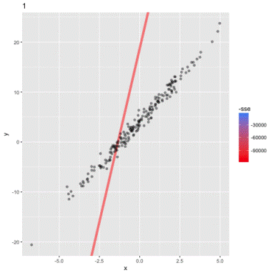
Objective Function
A classical linear programming problem can be stated as:
Find a vector u = (u₁, u₂, …, u_{m}) that minimizes the linear objective function:
u is arbitrarily constrained such that u_{i} > 0.
The solution to such an optimization problem is not unique.
A range of solutions lie in a convex polytope (an n-dimensional polyhedron).
Solutions can be found in polynomial time: O(n^{k})

Slide 5
Multi-objective functions
Multi-objective optimization (also known as multi-objective programming, vector optimization, multicriteria optimization, multiattribute optimization or Pareto optimization)
An area of multiple criteria decision making that is concerned with mathematical optimization problems involving more than one objective function to be optimized simultaneously.
For instance, a person 𝑋 wants to buy a cooling device which can serve his two objectives of maximum comfort and least cost

Slide 6
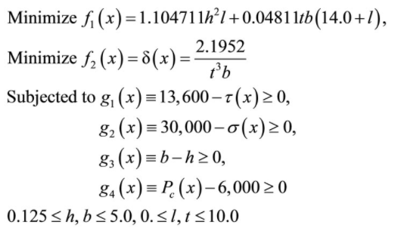
Case study on welded beam design problem
Among the four constraints, g₁ deals with the shear stress developed at the support location of the beam which is meant to be smaller than the allowable shear strength of the material (13,600 psi).
The g₂ guarantees that normal stress developed at the support location of the beam is smaller than the allowable yield strength of the material (30,000 psi).
The g₃ makes certain that thickness of the beam is not smaller than the weld thickness from the standpoint.
The g₄ keeps the allowable buckling load of the beam more than the applied load P for safe design. A violation of any of the above four constraints will make the design unacceptable.

Slide 7
Linear Regression
Decision Functions
y
Output
θ₁
θ₂
θ₃
θ_{M}
x₁
x₂
x₃
…
x_{M}
Input

Slide 8
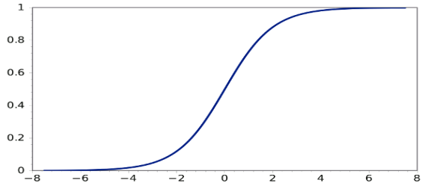
Logistic Regression
Decision Functions
y
Output
θ₁
θ₂
θ₃
θ_{M}
x₁
x₂
x₃
…
x_{M}
Input

Slide 9


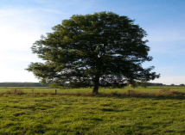
Logistic Regression
Decision Functions
y
Output
Face
Face
Not a face
θ₁
θ₂
θ₃
θ_{M}
x₁
x₂
x₃
…
x_{M}
Input

Slide 10
Logistic Regression
Decision Functions
y
Output
1
1
0
y
θ₂
θ₃
θ_{M}
x₂
θ₁
x₁
x₁
x₂
x₃
…
x_{M}
Input

Slide 11
Logistic Regression
Decision Functions
y
Output
θ₁
θ₂
θ₃
θ_{M}
x₁
x₂
x₃
…
x_{M}
Input

Slide 12
Objective Functions for NNs
Regression:
Use the same objective as Linear Regression
Quadratic loss (i.e. mean squared error)
Classification:
Use the same objective as Logistic Regression
Cross-entropy (i.e. negative log likelihood)
This requires probabilities, so we add an additional “softmax” layer at the end of our network

Slide 13
Neural Network
Decision Functions
Output
y
z₁
z₂
…
z_{D}
Hidden Layer
x₁
x₂
x₃
…
x_{M}
Input

Slide 14
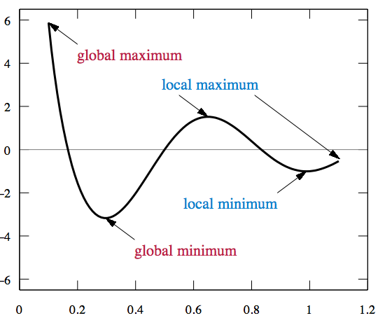
Search Space
To solve optimization problems, search for best state by optimizing an objective function.
f(x) where often x is a vector of continuous or discrete values
Types of Problems: Convex versus Multimodal

Slide 15
Strictly Convex Problems have a single optima
Local Optima = Global Optima
Hessian matrix has positive eigenvalues
F(x)
x*

Slide 16
Types of Problems: Convex versus Multimodal
Non Convex Problems may have multiple local optima
F(x)
x

Slide 17
The gradient of a straight line is given by
We use this idea to get the gradient at a point on a curve
Gradients are important as they measure the rate of change of one variable with another. For the graphs in this section, the gradient measures how y changes with x
This branch of Mathematics is called Calculus

Slide 18
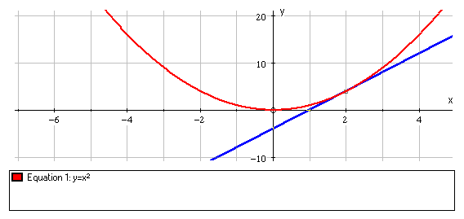
The Gradient at a point on a Curve
Definition: The gradient of a point on a curve equals the gradient of the tangent at that point.
e.g.
12
(2, 4)
x
3
Tangent at
The gradient of the tangent at (2, 4) is
So, the gradient of the curve at (2, 4) is 4

Slide 19
Increasing and Decreasing Functions
An increasing function is one whose gradient is always greater than or equal to zero.
for all values of x
A decreasing function has a gradient that is always negative or zero.
for all values of x

Slide 20
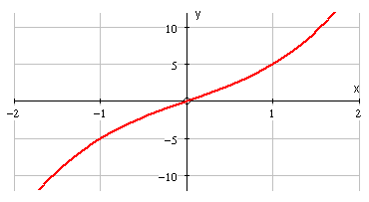
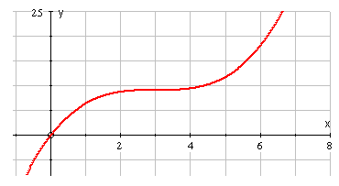
The graphs of the increasing functions and are
and

Slide 21
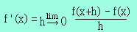
The derivative f'(x) of the function f(x) is the slope of the tangent at the point (x, f(x)).
A derivative f'(x) of a function f depicts how the function f is changing at point x.
f must be continuous at point x in order for there to be a derivative at that point. A function which has a derivative is said to be differentiable.

Slide 22
Average Rate of Change of f over [a, b]: Difference Quotient
The average rate of change of the function f over the interval [a, b] is
Average rate of change of
f = f = f(b) - f(a)
=Slope of line through points P and Q in the figure
x
b - a

Slide 23
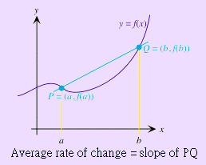
This average rate of change the
diff quotient of f over the interval [a, b].

Slide 24
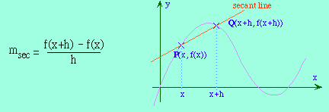
Slope of the Secant Line and Slope of the Tangent Line
The slope of the secant line through
(x, f(x)) and (x+h, f(x+h)) is the same as the average rate of change of f over the interval [x, x+h], or the difference quotient:

Slide 25
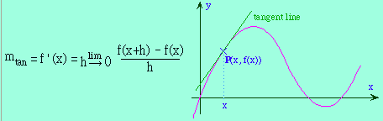
The slope of the tangent line through
(x, f(x)) is the same as the instantaneous
rate of change of f at the point x, or the derivative:

Slide 26
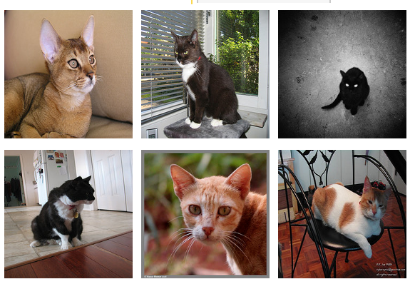
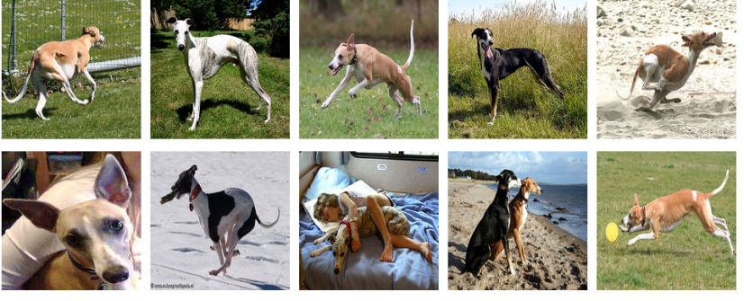
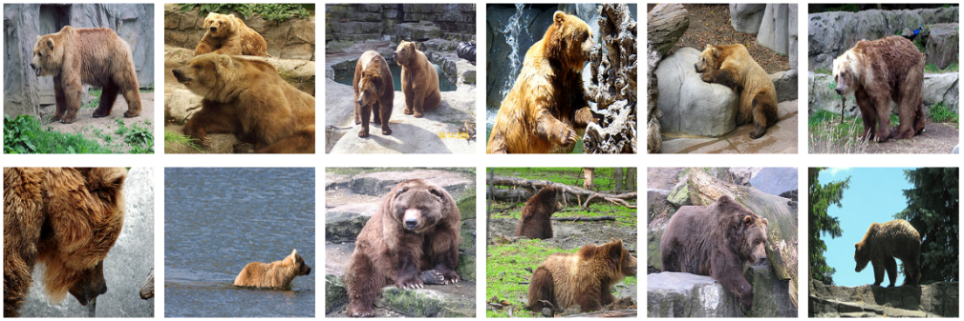





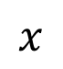
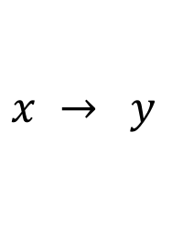
Supervised Learning vs Unsupervised Learning
$$x → y$$
$$x$$
cat
dog
bear
dog
bear
dog
cat
cat
bear

Slide 27
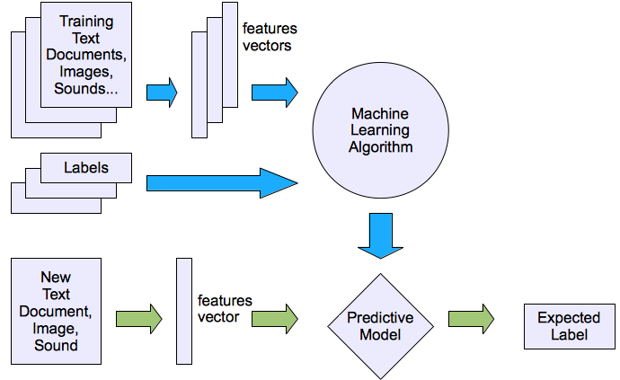
Illustrating Classification Tasks (contd..)

Slide 28
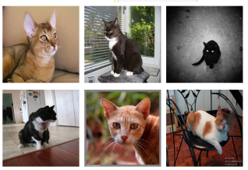
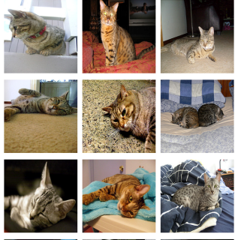



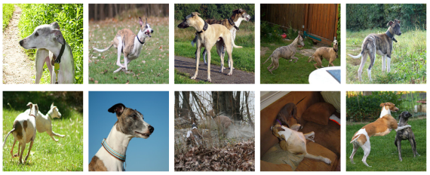
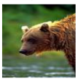

Supervised Learning - Classification
Training Data
Test Data
cat
dog
cat
.
.
.
.
.
.
bear

Slide 29
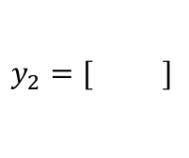
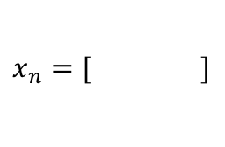
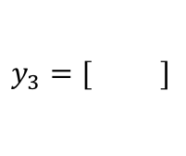
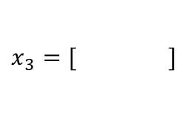
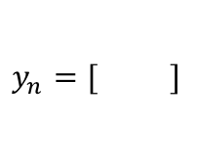
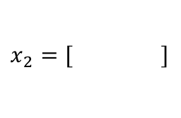
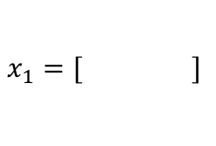
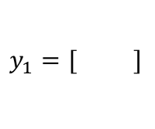
Supervised Learning - Classification
Training Data
cat
$$x_{1}=[ ]$$
$$y_{1}=[ ]$$
dog
$$x_{2}=[ ]$$
$$y_{2}=[ ]$$
cat
$$x_{3}=[ ]$$
$$y_{3}=[ ]$$
.
.
.
bear
$$x_{n}=[ ]$$
$$y_{n}=[ ]$$

Slide 30
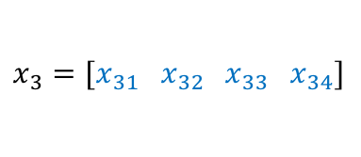
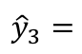
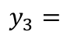
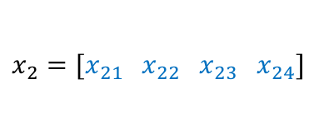
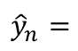
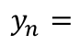
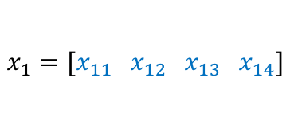
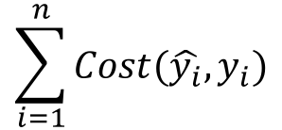
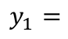
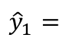
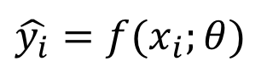
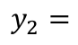
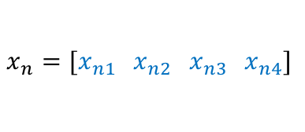
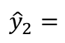
Supervised Learning - Classification
Training Data
targets /
labels /
ground truth
We need to find a function that
maps x and y for any of them.
inputs
predictions
$$x_{1}=[x_{11} { x}_{12} x_{13} { x}_{14}]$$
$$y_{1}=$$
1
$${\hat{y}}_{1}=$$
1
$$\hat{y_{i}}=f(x_{i};θ)$$
$$x_{2}=[x_{21} { x}_{22} x_{23} { x}_{24}]$$
$$y_{2}=$$
2
$${\hat{y}}_{2}=$$
2
$$x_{3}=[x_{31} { x}_{32} x_{33} { x}_{34}]$$
$$y_{3}=$$
1
$${\hat{y}}_{3}=$$
2
How do we ”learn” the parameters
of this function?
.
.
.
We choose ones that makes the
following quantity small:
$$\sum_{i=1}^{n}{Cost(\hat{y_{i}}, y_{i})}$$
$$x_{n}=[x_{n1} { x}_{n2} x_{n3} { x}_{n4}]$$
$$y_{n}=$$
3
$${\hat{y}}_{n}=$$
1

Slide 31
Supervised Learning – Linear Softmax
Training Data
targets /
labels /
ground truth
inputs
$$x_{1}=[x_{11} { x}_{12} x_{13} { x}_{14}]$$
$$y_{1}=$$
1
$$x_{2}=[x_{21} { x}_{22} x_{23} { x}_{24}]$$
$$y_{2}=$$
2
$$x_{3}=[x_{31} { x}_{32} x_{33} { x}_{34}]$$
$$y_{3}=$$
1
.
.
.
$$x_{n}=[x_{n1} { x}_{n2} x_{n3} { x}_{n4}]$$
$$y_{n}=$$
3

Slide 32
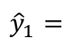
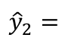
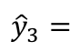
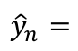
Supervised Learning – Linear Softmax
Training Data
targets /
labels /
ground truth
inputs
predictions
$$x_{1}=[x_{11} { x}_{12} x_{13} { x}_{14}]$$
$$y_{1}=$$
[1 0 0]
$${\hat{y}}_{1}=$$
[0.85 0.10 0.05]
$$x_{2}=[x_{21} { x}_{22} x_{23} { x}_{24}]$$
$$y_{2}=$$
[0 1 0]
$${\hat{y}}_{2}=$$
[0.20 0.70 0.10]
$$x_{3}=[x_{31} { x}_{32} x_{33} { x}_{34}]$$
$$y_{3}=$$
[1 0 0]
$${\hat{y}}_{3}=$$
[0.40 0.45 0.05]
.
.
.
$$x_{n}=[x_{n1} { x}_{n2} x_{n3} { x}_{n4}]$$
$$y_{n}=$$
[0 0 1]
$${\hat{y}}_{n}=$$
[0.40 0.25 0.35]

Slide 33
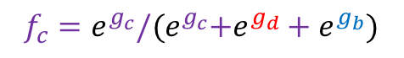
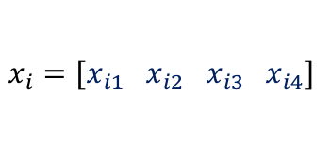




Supervised Learning – Linear Softmax
$$x_{i}=[x_{i1} { x}_{i2} x_{i3} { x}_{i4}]$$
$$y_{i}=$$
[1 0 0]
$${\hat{y}}_{i}= [f_{c} f_{d} f_{b}]$$
$$g_{c}=w_{c1}x_{i1}+w_{c2}x_{i2}+w_{c3}x_{i3}+w_{c4}x_{i4}+b_{c}$$
$$g_{d}=w_{d1}x_{i1}+w_{d2}x_{i2}+w_{d3}x_{i3}+w_{d4}x_{i4}+b_{d}$$
$$g_{b}=w_{b1}x_{i1}+w_{b2}x_{i2}+w_{b3}x_{i3}+w_{b4}x_{i4}+b_{b}$$
$$f_{c}=e^{g_{c}}/{(e}^{g_{c}}+e^{g_{d}}+e^{g_{b}})$$
$$f_{d}=e^{g_{d}}/{(e}^{g_{c}}+e^{g_{d}}+e^{g_{b}})$$
$$f_{b}=e^{g_{b}}/{(e}^{g_{c}}+e^{g_{d}}+e^{g_{b}})$$

Slide 34




How do we find a good w and b?
$$x_{i}=[x_{i1} { x}_{i2} x_{i3} { x}_{i4}]$$
$$y_{i}=$$
[1 0 0]
$${\hat{y}}_{i}= [f_{c}(w,b) f_{d}(w,b) f_{b}(w,b)]$$
We need to find w, and b that minimize the following:
$$L\left(w,b\right)=\sum_{i=1}^{n}{\sum_{j=1}^{3}{−y_{i,j}log⁡({\hat{y}}_{i,j})}}$$
$$=\sum_{i=1}^{n}{−log⁡({\hat{y}}_{i,label})}$$
$$=\sum_{i=1}^{n}{−log f_{i,label}(w,b)}$$
Why?

Slide 35







Gradient Descent (GD)
expensive
$$λ=0.01$$
$$L(w,b)=\sum_{i=1}^{n}{−log f_{i,label}(w,b)}$$
Initialize w and b randomly
for e = 0, num_epochs do
Compute:
$$dL(w,b)/dw$$
and
$$dL(w,b)/db$$
Update w:
$$w=w −λ dL(w,b)/dw$$
Update b:
$$b=b −λ dL(w,b)/db$$
Print:
$$L(w,b)$$
// Useful to see if this is becoming smaller or not.
end

Slide 36


Gradient Descent (GD) (idea)
1. Start with a random value of w (e.g. w = 12)
$$L\left(w\right)$$
2. Compute the gradient (derivative) of L(w) at point w = 12. (e.g. dL/dw = 6)
3. Recompute w as:
w = w – lambda * (dL / dw)
w=12
$$w$$

Slide 37
Gradient Descent (GD) (idea)
$$L\left(w\right)$$
2. Compute the gradient (derivative) of L(w) at point w = 12. (e.g. dL/dw = 6)
3. Recompute w as:
w = w – lambda * (dL / dw)
w=10
$$w$$

Slide 38






Gradient descent
Initialize $θ_{0}$ randomly
For t in 0,…, T_{maxiter}
$$θ^{t+1}=θ^{t}−η_{t}⋅∇L\left(θ^{t}\right)$$
$$θ_{t+1}$$
$$θ_{t}$$
$$θfinal$$
Gradient of the objective
Learning rate (step size)
$$θ0$$
computation of $∇L\left(θ^{t}\right)$ requires a full sweep over the training data
Per-iteration comp. cost = O(n)

Slide 39


Stochastic gradient descent (SGD)
Initialize $θ_{0}$ randomly
For t in 0,…, T_{maxiter}
$$θ^{t+1}=θ^{t}−η_{t}⋅∇Loss\left(f_{θ}\left(x_{i}\right), y_{i}\right)$$
where index i is chosen randomly
$$θ_{t+1}$$
$$θ_{t}$$
$$θfinal$$
Stochastic gradient
$$θ0$$
computation of $∇Loss\left(…\right)$ requires only one training example
Per-iteration comp. cost = O(1)

Slide 40


Minibatch stochastic gradient descent
Initialize $θ_{0}$ randomly
For t in 0,…, T_{maxiter}
$$θ^{t+1}=θ^{t}−η_{t}⋅{\tilde{∇}}_{B}L\left(θ\right)$$
where minibatch B is chosen randomly
$$θ_{t+1}$$
$$θ_{t}$$
$$θfinal$$
minibatch gradient
$$θ0$$
$\tilde{∇}L\left(θ\right)$is average gradient over random subset of data of size B
Per-iteration comp. cost = O(B)

Slide 41






(mini-batch) Stochastic Gradient Descent (SGD)
$$λ=0.01$$
$$l(w,b)=\sum_{i∈B}{−log f_{i,label}(w,b)}$$
Initialize w and b randomly
for e = 0, num_epochs do
for b = 0, num_batches do
Compute:
$$dl(w,b)/dw$$
and
$$dl(w,b)/db$$
Update w:
$$w=w −λ dl(w,b)/dw$$
Update b:
$$b=b −λ dl(w,b)/db$$
Print:
$$l(w,b)$$
// Useful to see if this is becoming smaller or not.
end
end

Slide 42
https://towardsdatascience.com/optimizers-for-training-neural-network-59450d71caf6

Slide 43



Training Phase
Sample labeled data
(batch)
Forward it through the network, get predictions
Back-propagate the errors
Update the network weights
Optimize (min. or max.) objective/cost function $J(θ)$
Generate error signal that measures difference between predictions and target values
Use error signal to change the weights and get more accurate predictions
Subtracting a fraction of the gradient moves you towards the (local) minimum of the cost function
https://medium.com/@ramrajchandradevan/the-evolution-of-gradient-descend-optimization-algorithm-4106a6702d39

Slide 44





Loss functions and output
Classification
Regression
Training
examples
R^{n} x {class_1, ..., class_n}
(one-hot encoding)
R^{n} x R^{m}
Output
Layer
Soft-max
[map R^{n} to a probability distribution]
Linear (Identity)
or Sigmoid
f(x)=x
Cost (loss)
function
Cross-entropy
Mean Squared Error
Mean Absolute Error
List of loss functions
$$J\left(θ\right)= \frac{1}{n}\sum_{i=1}^{n}{{\left(y^{(i)}−{\hat{y}}^{(i)}\right)}^{2}}$$
$$J\left(θ\right)=−\frac{1}{n}\sum_{i=1}^{n}{\sum_{k=1}^{K}{\left[y_{k}^{(i)}\log{{\hat{y}}_{k}^{(i)}+\left(1−y_{k}^{(i)}\right) }\log\left(1− {\hat{y}}_{k}^{\left(i\right)}\right)\right]}}$$
$$J\left(θ\right)= \frac{1}{n}\sum_{i=1}^{n}{\left|y^{(i)}−{\hat{y}}^{(i)}\right|}$$
Notes:
Exponentiate to make it positive
MSE has nice mathematical properties which makes it easier to compute the gradient
Because of the square, large errors have relatively greater influence on MSE.
Therefore, MAE is more robust to outliers since it does not make use of square.

Slide 45





Last Time: Loss Functions
We have some dataset of (x,y)
We have a score function:
We have a loss function:
e.g.
Softmax
SVM
Full loss

Slide 46



Choice of learning rate rate
Too small learning rate will take too long
Too large, the next point will perpetually bounce haphazardly across the bottom of the well
If gradient is small then you
can safely try a larger learning rate, which compensates for the small gradient and results in a larger step size

Slide 47



The effects of step size (or “learning rate”)

Slide 48
Optimizer Algorithms

Slide 49



Slide 50




Slide 51



Momentum - The velocity accumulates the previous gradients

Slide 52



Slide 53



Slide 54


Slide 55

AdaGrad
AdaGrad is good when the objective is convex.
AdaGrad might shrink the learning rate too aggressively, we want to keep the history in mind
We can adapt it to perform better in non-convex settings by accumulating an exponentially decaying average of the gradient

Slide 56


Slide 57


Slide 58

List of Optimizers

Slide 59

Adagrad

Slide 60

RMS prop

Slide 61

Adam

Slide 62

Summary of Optimizers
SGD with momentum, Nestrov Accelerated Gradient
Adagrad – each parameter @ diff learning rate
Adadelta - Adadelta restricts the window of accumulated past gradients to some fixed size ’w’
RMSprop - divides the learning rate by an exponentially decaying average of squared gradients
Adam - keeps an exponentially decaying average of past gradients

Slide 63
Additional strategies for SGD
Shuffling order of datapoints in SGD
Batch normalization
Early stopping
Gradient noise

Slide 64



Slide 65
Nature Inspired Search Optimization Techniques

Slide 66
Population-based metaheuristics
Nature-inspired
Initialize a population
A new population of solutions is generated
Integrate the new population into the current one using one these methods – by replacement which is a selection process from the new and current solutions
Swarm Intelligence
Ant colony optimization (ACO)
Particle swarm optimization (PSO)
Bee colony
Artificial Immune system AIS
Continue until a stopping criteria is reached
The generation and replacement process could be memory less or some search memory is used

Slide 67
Ant Colony Optimization (ACO)
Dorigo & Gambardella introduced four modifications in AS :
1.a different transition rule,
2.Local/global pheromone trail updates,
3.use of local updates of pheromone trail to favor exploration
4.a candidate list to restrict the choice of the next city to visit.

Slide 68

Search Space
Discrete Graph
To each edge is associated a static value
returned by an heuristic function η (r,s)
based on the edge-cost
Each edge of the graph is augmented with a pheromone trail τ (r,s) deposited by ants.
Pheromone is dynamic and it is learned at run-ime

Slide 69
Ant Systems (AS)
Ant Systems for TSP
Graph (N,E): where N = cities/nodes, E = edges
= the tour cost from city i to city j (edge weight)
Ant move from one city i to the next j with some transition probability.
B
A
D
C

Slide 70

ACS : Ant Colony System for TSP

Slide 71
Ant Systems Algorithm for TSP
Initialize
Place each ant in a randomly chosen city
For Each Ant
Choose NextCity(For Each Ant)
yes
more cities
to visit
No
Return to the initial cities
Update pheromone level using the tour cost for each ant
No
Stopping
criteria
yes
Print Best tour

Slide 72

Rules for Transition Probability
1. Whether or not a city has been visited
Use of a memory(tabu list): : set of all cities that are to be visited
= visibility: Heuristic desirability of choosing city j when in city i.
3.Pheromone trail: This is a global type of information
Transition probability for ant k to go from city i to city j while building its route.
a = 0: closest cities are selected

Slide 73


Trail pheromone in AS
After the completion of a tour, each ant lays some pheromone
for each edge that it has used. depends on how well the ant
has performed.
Trail pheromone decay =

Slide 74

Particle Swarm Optimization (PSO)
A particle has a neighbourhood associated with it.
A particle knows the fitnesses of those in its neighbourhood, and uses the position of the one with best fitness.
This position is simply used to adjust the particle’s velocity
Each particle is searching for the optimum
Each particle is moving and hence has a velocity.
Each particle remembers the position it was in where it had its best result so far (its personal best)

Slide 75


PSO -Algorithm
[x*] = PSO()
P = Particle_Initialization();
For i=1 to it_max
For each particle p in P do
fp = f(p);
If fp is better than f(pBest)
pBest = p;
end
end gBest = best p in P;
For each particle p in P do
v = v + c1*rand*(pBest – p) + c2*rand*(gBest – p);
p = p + v; end end

Slide 76
Particle update rule: p = p + v
with v = v + c₁ * rand * (pBest – p) + c₂ * rand * (gBest – p)
where
p: particle’s position
v: path direction
c₁: weight of local information
c₂: weight of global information
pBest: best position of the particle
gBest: best position of the swarm
rand: random variable
Notes:
c1, c2 : The balance factors between the effect of self-knowledge and social knowledge in moving the particle towards the target. Usually the value 2 is suggested for both factors in the literature)
rand :A random number between 0 and 1, and different at each iteration
w : Inertia weight
pbest : The best position of a particle
gbest : The best position within the swarm
prtvel : The velocity of jth particle in ith iteration
prtpos : The position of jth particle in ith iteration

Slide 77
PSO parameters
Number of particles usually between 10 and 50
C₁ is the importance of personal best value
C₂ is the importance of neighborhood best value
Usually C₁ + C₂ = 4 (empirically chosen value)
If velocity is too low → algorithm too slow
If velocity is too high → algorithm too unstable
Demo - http://www.macs.hw.ac.uk/~dwcorne/mypages/apps/pso.html

Slide 78

Gray-Wolf Optimization hunting mechanism contains three steps: tracking, encircling and attacking the prey

Slide 79



GWO - Algorithm
encircling behavior

Slide 80



Mathematical model for hunting
alpha, beta, and delta estimate the position of the prey, and other wolves update their positions randomly around the prey

Slide 81
Coding for Optimization

Slide 82
Overview
Gradient descent is the standard algorithm

Slide 83

Variants of gradient descent
Stochastic gradient descent

Slide 84

Variants of gradient descent
Mini batch SGD

Slide 85
Implementing Optimizers in Python
SGD − Storchastic gadient descent optimizer.
tf.keras.optimizers.SGD(learning_rate = 0.01, momentum = 0.0, nesterov = False, name="SGD")
RMSprop − RMSProp optimizer.
tf.keras.optimizers.RMSprop(learning_rate = 0.001, rho = 0.9)
Adagrad − Adagrad optimizer.
tf.keras.optimizers.Adagrad(learning_rate = 0.01)
Adadelta − Adadelta optimizer.
tf.keras.optimizers.Adadelta(learning_rate = 1.0, rho = 0.95)
Adam − Adam optimizer.
tf.keras.optimizers.Adam( learning_rate = 0.001, beta_1 = 0.9, beta_2 = 0.999, amsgrad = False )

Slide 86

Implementing Update Rule

Slide 87
Compile the model
compile( optimizer, loss = None, metrics = None, loss_weights = None, sample_weight_mode = None, weighted_metrics = None, target_tensors = None )

Slide 88
from keras import losses from keras import optimizers from keras import metrics model.compile(loss = 'mean_squared_error', optimizer = 'sgd', metrics = [metrics.categorical_accuracy])

Slide 89
Sample Keras Projects
https://keras.io/examples/

Slide 90


